Slide 1

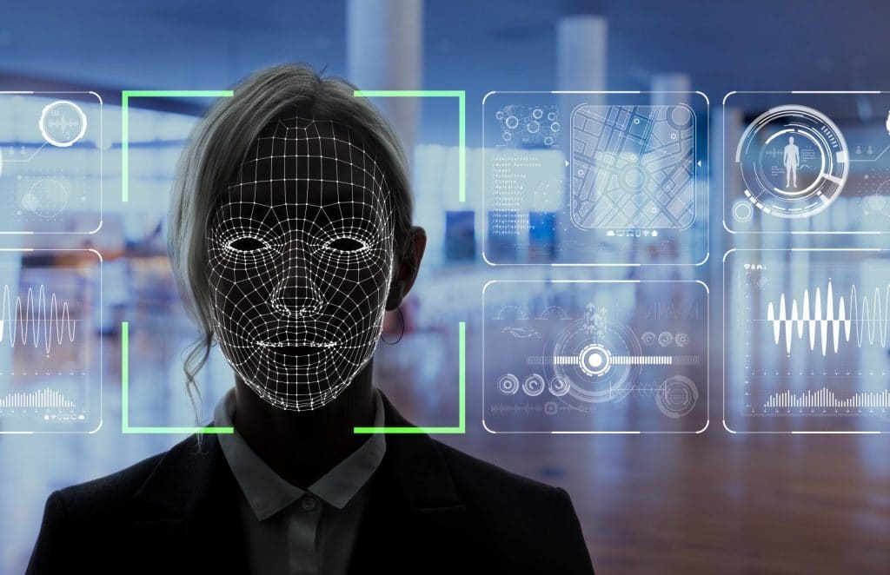
AUTOMATED ATTENDANCE SYSTEM
A facial recognition-based solution to modern problems
Under the Guidance of
Sri. B Sateesh
Dr. Kolla Morarjee

Slide 2

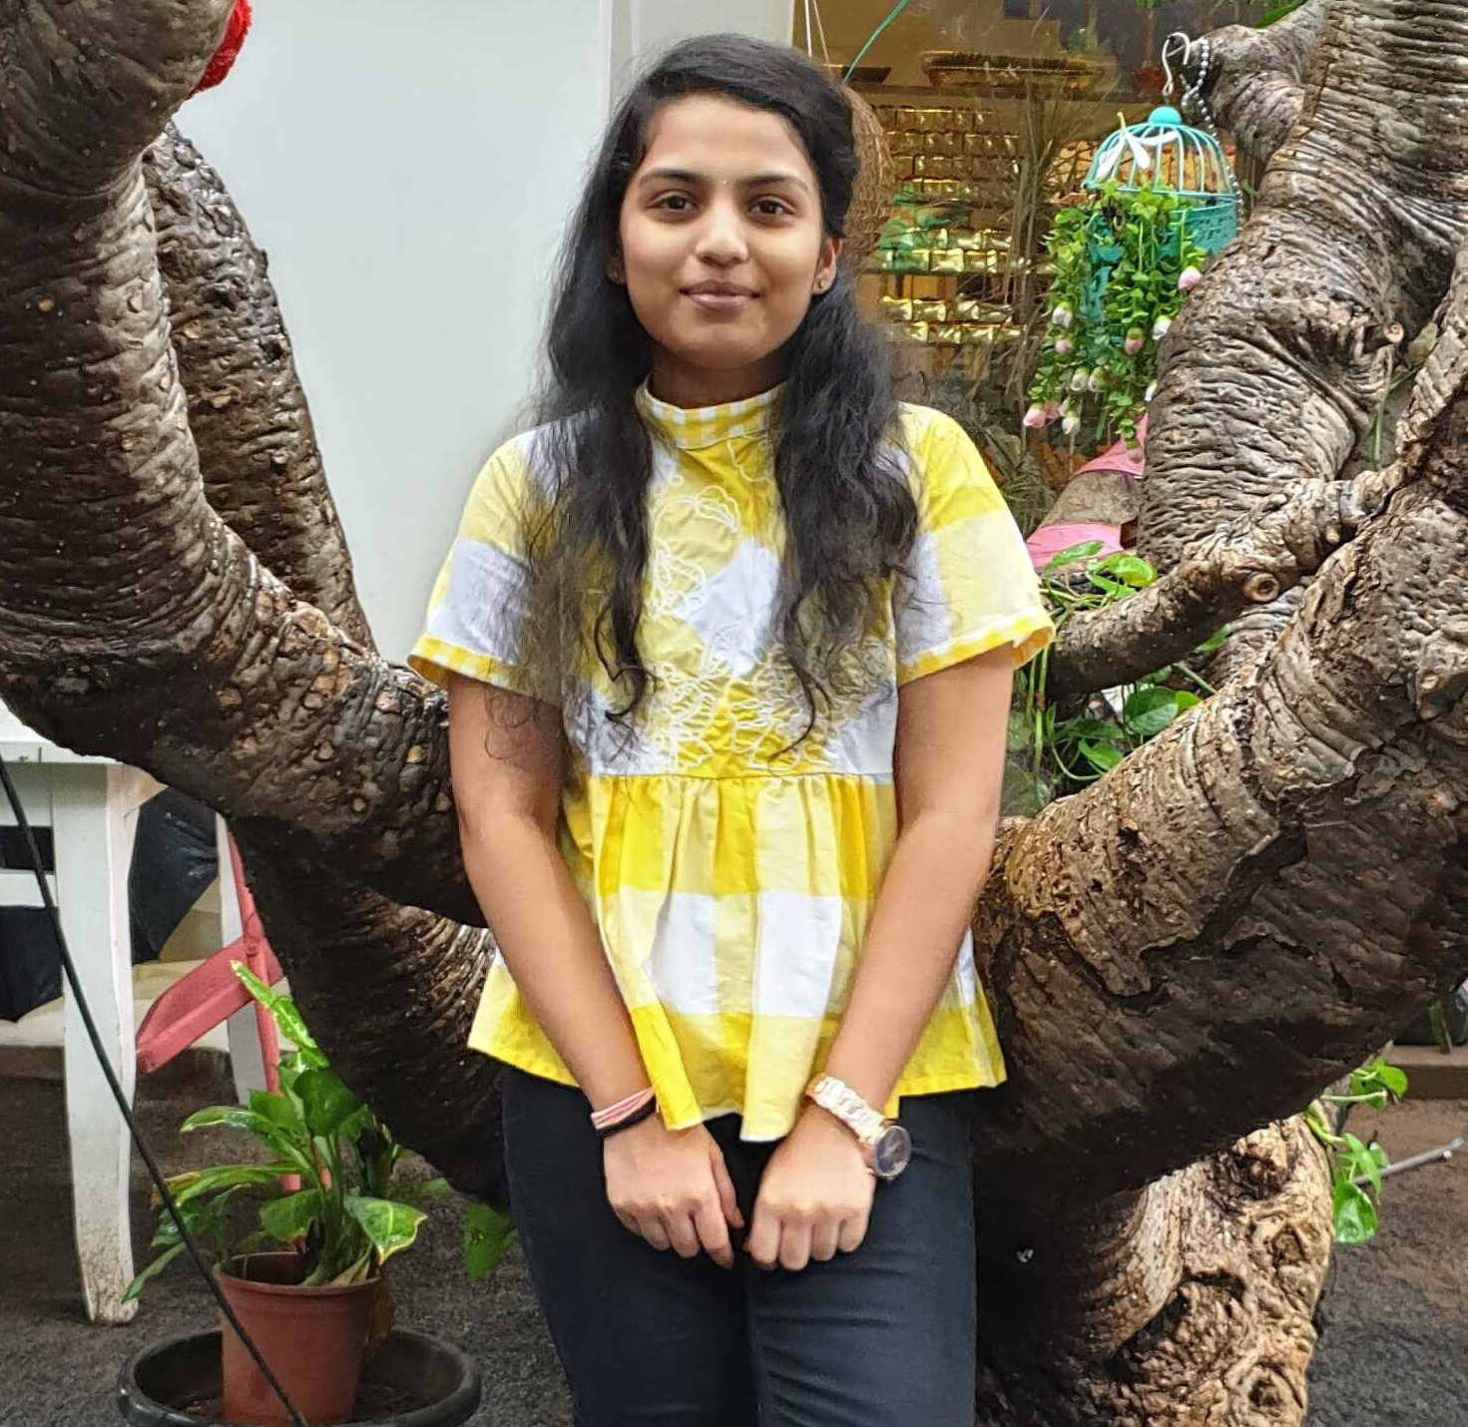
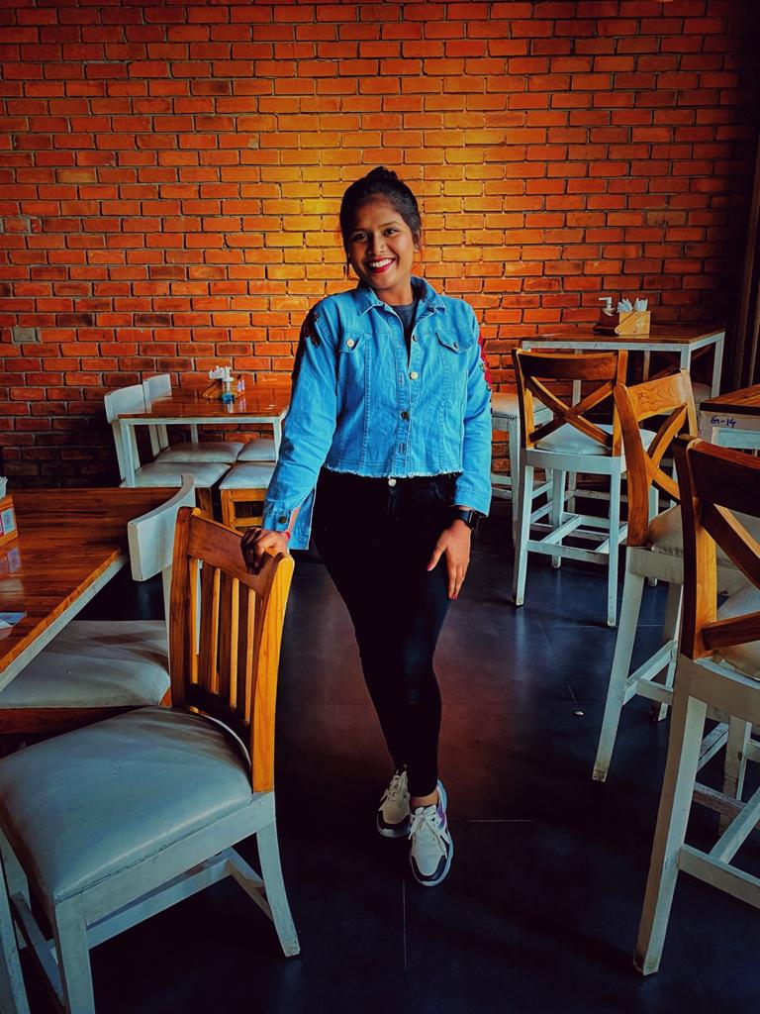
team
KOMALI BEERAM
1601 18 733 067
K tina
1601 18 733 086
Bachelor of Engineering ¾
Computer Science and Engineering
CBIT
Bachelor of Engineering ¾
Computer Science and Engineering
CBIT

Slide 3
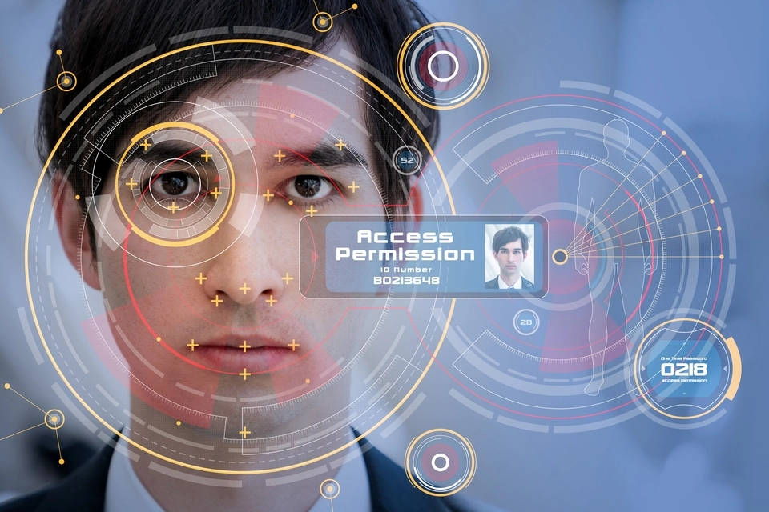
purpose
To overcome the challenges/ drawbacks of previous and existing systems such as-
Lack of efficiency
Lack of robust and error free systems
Lack of efficiency and accuracy of previous existing algorithms
Proxies
Cost
Time consuming
Speed
Fail to recognize faces when illuminated, rotated etc.
1601 18 733 067
1601 18 733 086

Slide 4

SOLUTION
To implement an effective, automate system that
Detects face
Extracts features
Recognizes faces
Marks's attendance
Cost effective
Saves time
Accurate and efficient.
1601 18 733 067
1601 18 733 086

Slide 5


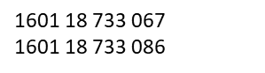
Google collab
64-bit Windows
4GB RAM
i5 processor
REQUIREMENTS
Python
Tensorflow
Facenet keras model
Keras
Numpy
Sklearn
Openpyxl
MTCNN
Operating environment

Slide 6
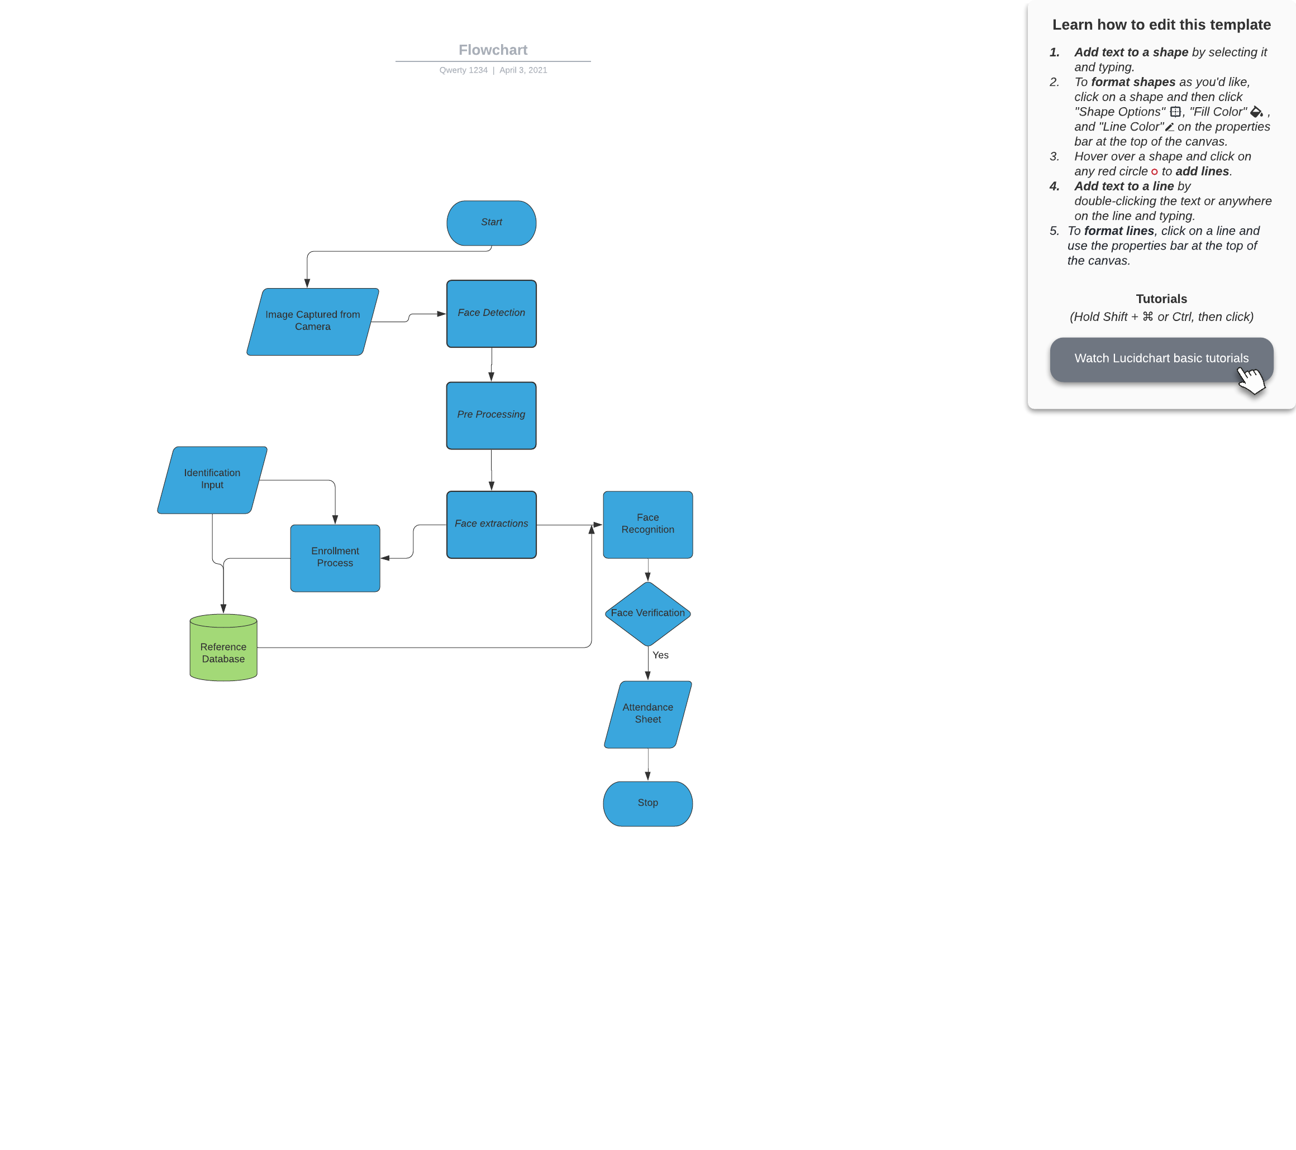
METHODOLOGY
1601 18 733 067
1601 18 733 086

Slide 7

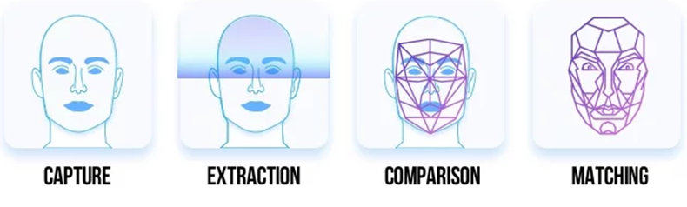


IMPLEMENTATION
DATABASE CREATION
MARKING

Slide 8

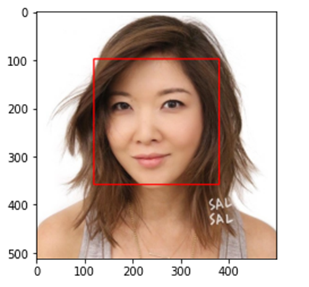
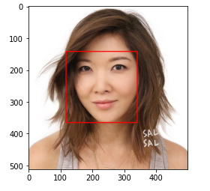

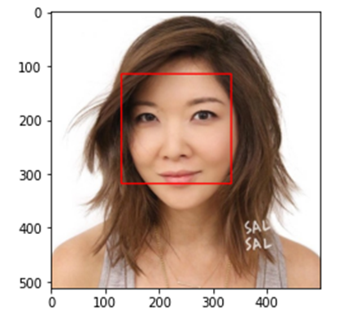
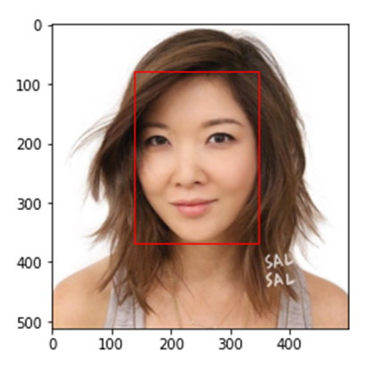
Comparison- detection
← Dlib cnn
Haar cascade →
← mtcnn
Dlib hog→

Slide 9
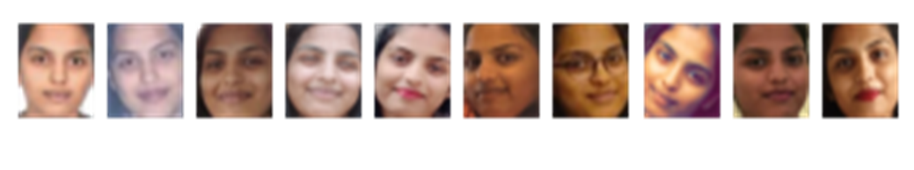

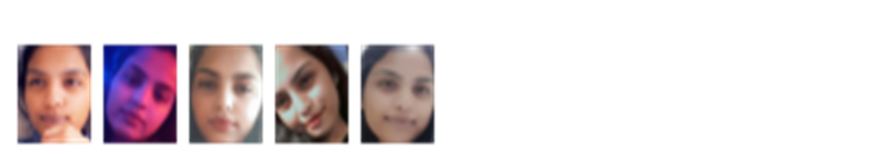
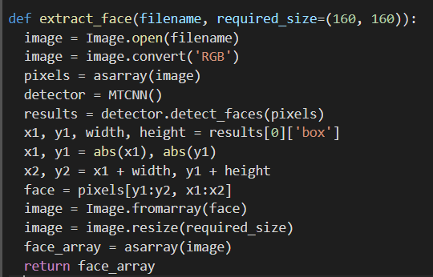

Face detection
code
output

Slide 10
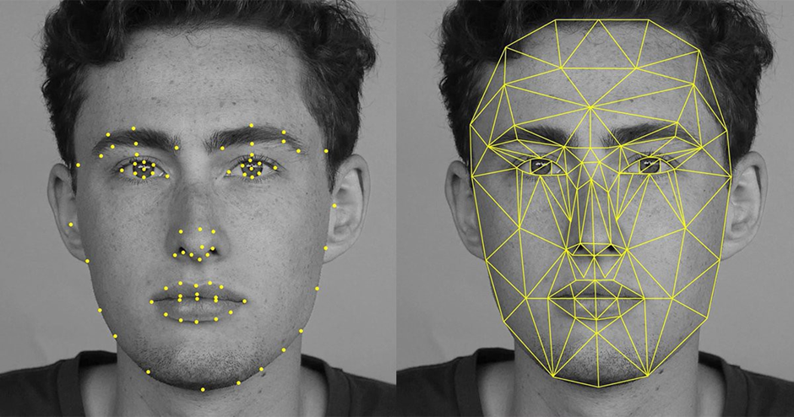
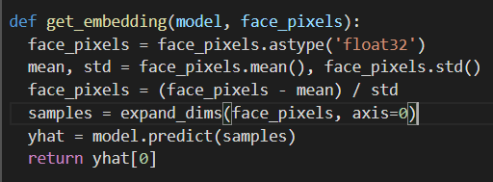
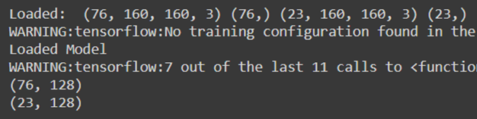
Face embeddings
code
output

Slide 11
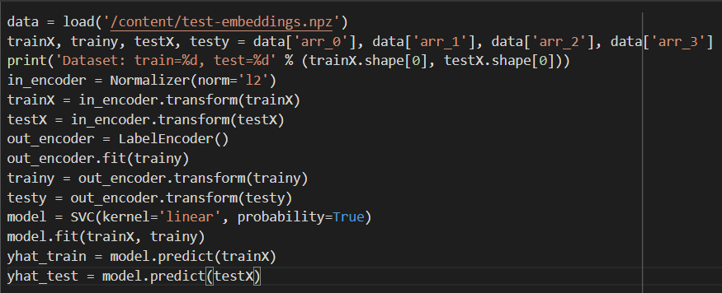
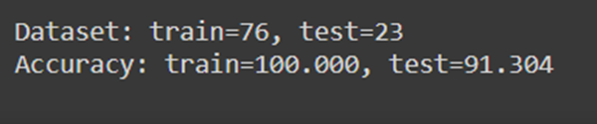
Face classification
code
output

Slide 12
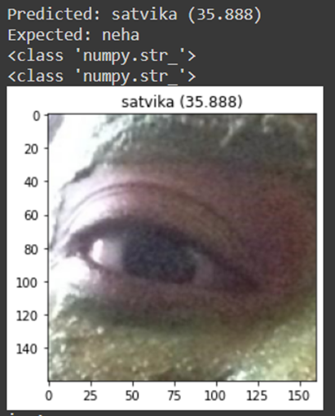

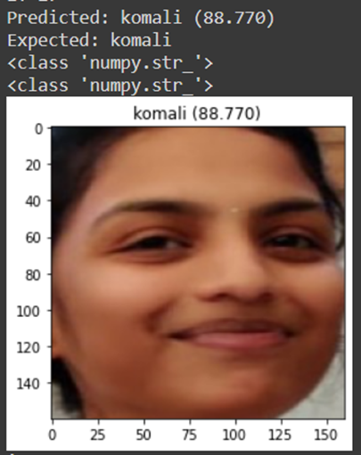
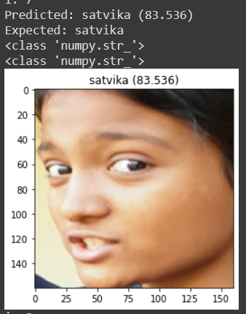

Face classification
Successful cases
Unsuccessful cases

Slide 13
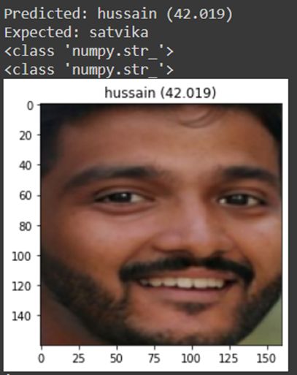
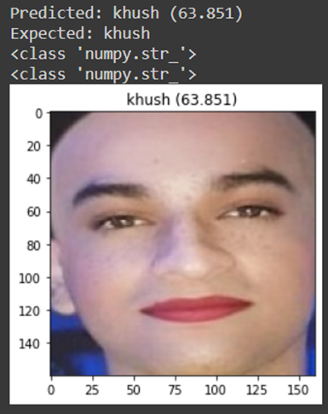
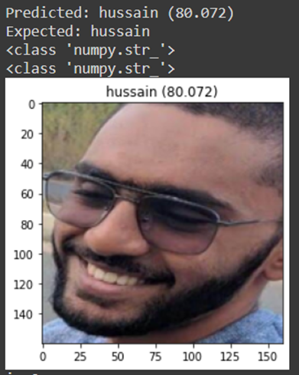
Face classification
Successful cases
Unsuccessful cases

Slide 14
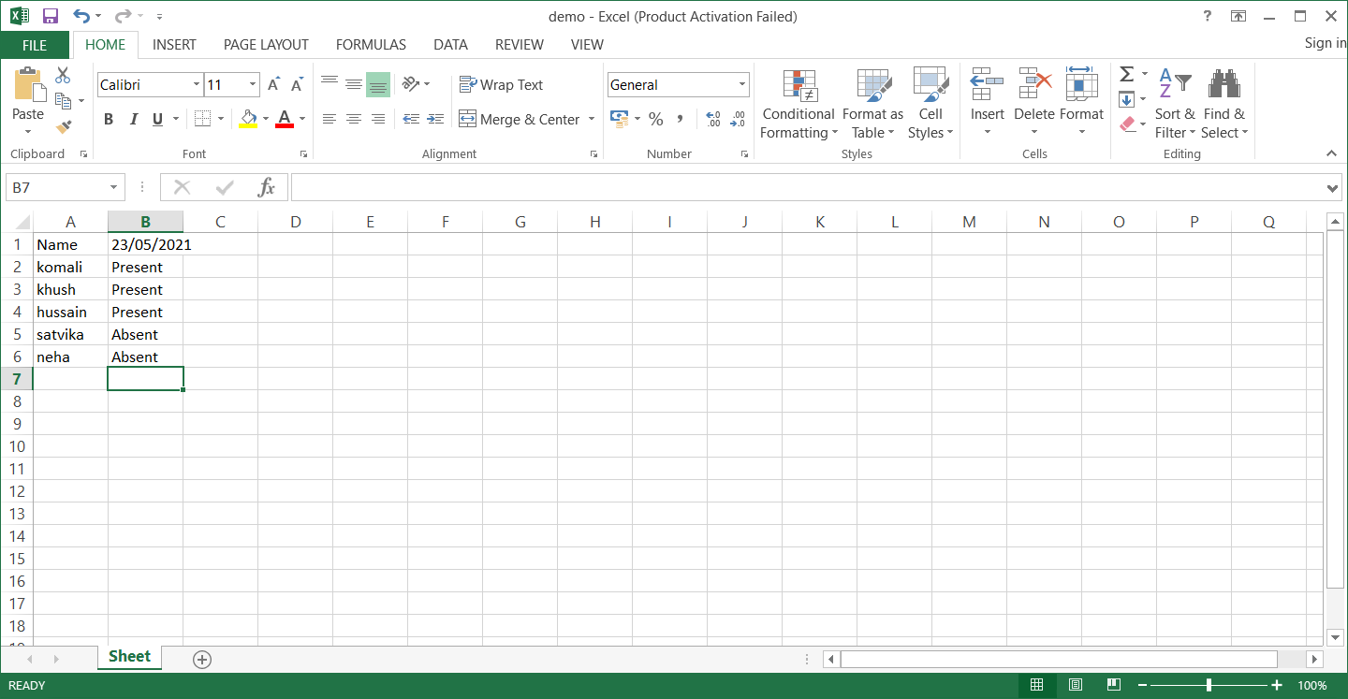
ATTENDANCE MARKING
1601 18 733 067
1601 18 733 086

Slide 15

Future Work
To detect multiple faces from a single image.
To check using identical twins.
To check on faces that went through
surgery.
Enable camera input.
Deploy into a web application.
Use cloud-based face recognition.
Increase the speed further.
Improve accuracy.
Integrate into ERP website by using CBIT’s
real-time data.
1601 18 733 067
1601 18 733 086

Slide 16
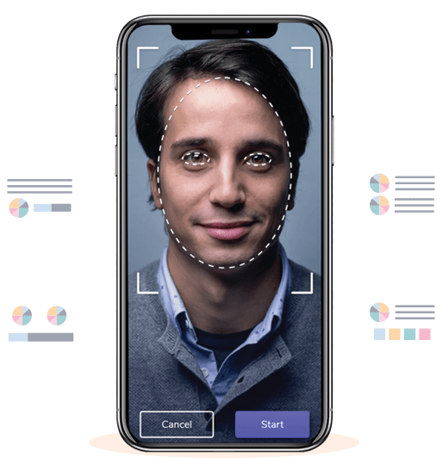
Thank you
Flora@contoso.com

